Slide 1
VinHack A hackathon by VinnovateIT
Team <7>

Slide 2
Problem Statement
Make a portal for the purpose of efficient and effective hostel room allotment in VIT for registered students where students can start a campaign for getting roommates and where people can find suitable hosts to incorporate them into the rooms

Slide 3
Technology Used
XAMPP
NOTEPAD
GITHUB
SQL
HOW IT WORKS
Login
Find your roommate
Fill up the Details
Take up the quiz and find the matches
Pick up your Roommate

Slide 4
UI & UX

Slide 5
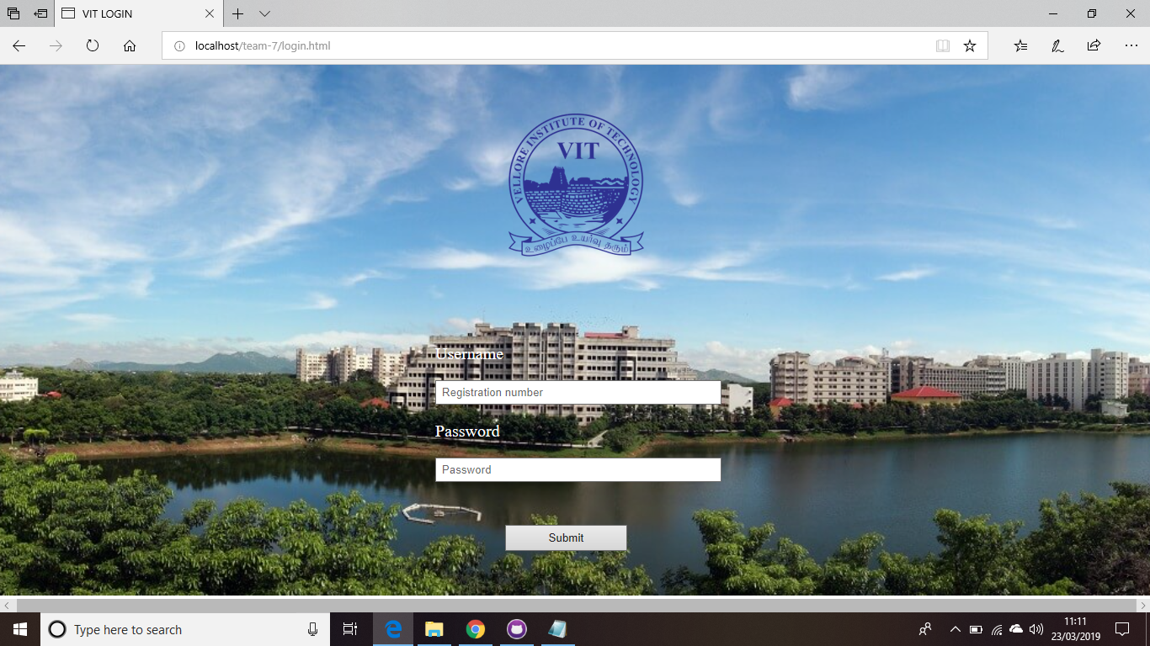

Slide 6
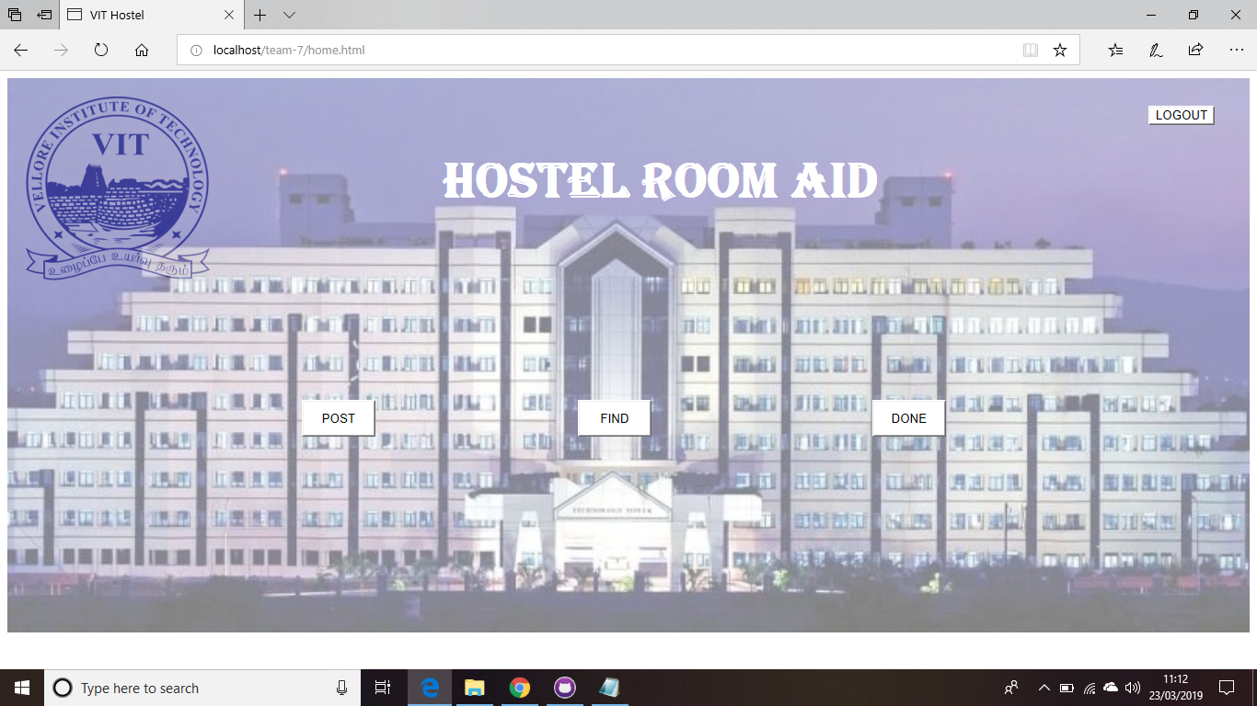

Slide 7
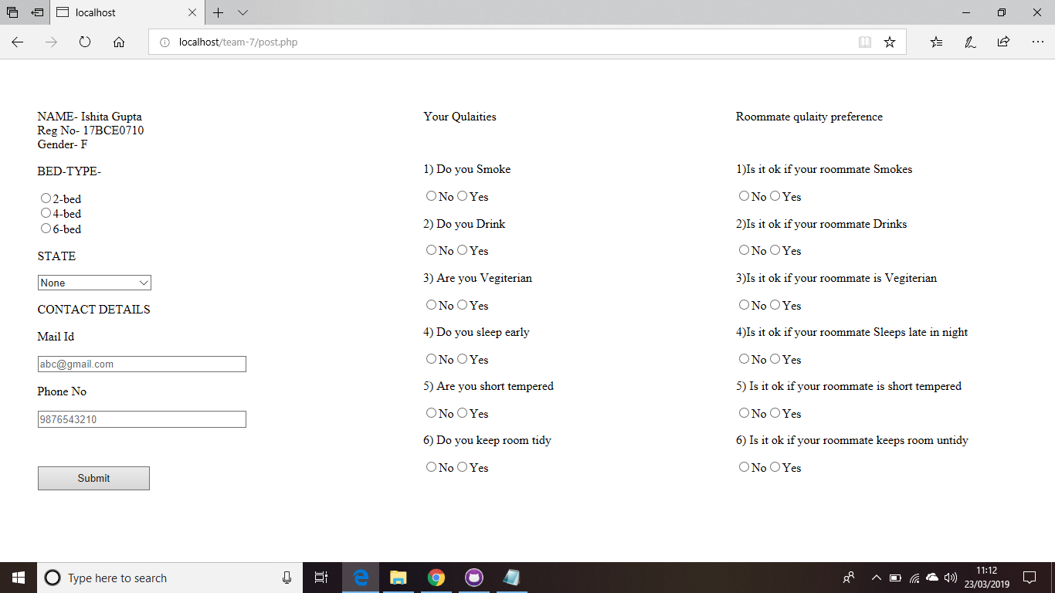

Slide 8
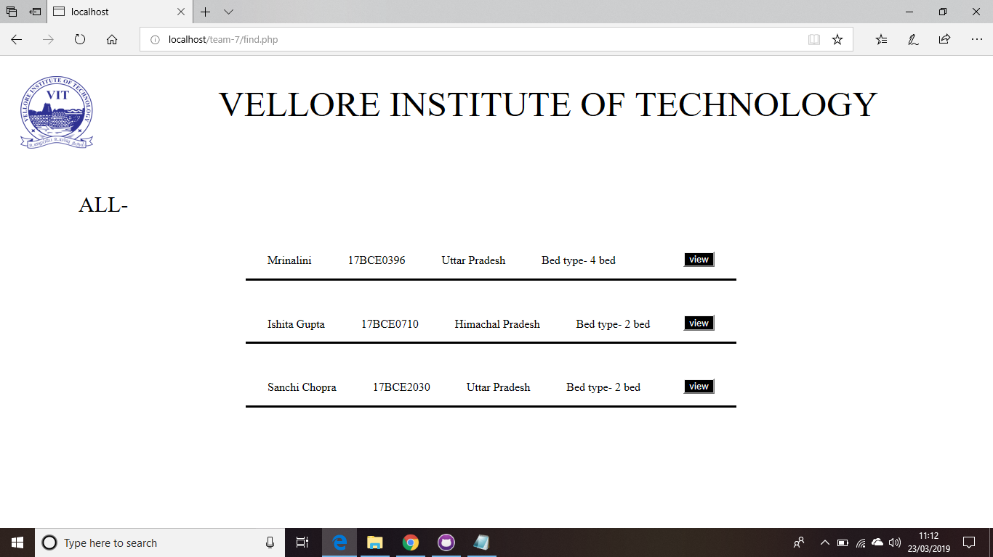

Slide 9
Team Members
Ishita Gupta – 17BCE0710
Mrinalini Singh-17BCE0396

Slide 10
Demo
https://github.com/IshitaGuptaa/Team-7

Slide 11
Usefulness and Feasibility
To find compatible roommates with ease.
No chance of fake accounts
You get the chance to explore more people as future roommates in short span of time.
Free of cost

Slide 12
Future Plans
To introduce roommate eligibilty based on the payment
To introduce chat box on the platform
To introduce this on large scale rather than just VIT . For example-flatmates,roommates.

Slide 13
Thank You

